Slide 1
Author Name and Degree Here
Your organization here
Date for presentation
Name of meeting

Slide 2
Objective of this presentation
To describe the Priorities for Local AIDS Control (PLACE) method
Aim
Objectives
Outputs
Problem addressed by PLACE
The 4 pillars of PLACE
The 3 phases of PLACE
In practice: How does PLACE work?
How PLACE differs from other surveillance methods and surveys

Slide 3
What is the PLACE method?
PLACE: Priorities for Local AIDS Control Efforts
PLACE is a rapid assessment tool to help local programs identify where to reach people most at risk of acquiring and transmitting HIV and provide evidence to support tailored interventions to reduce HIV transmission.
Notes:
Every day, more and more people acquire HIV, the virus that causes AIDS.
To combat AIDS, we need tools that are rapid, valid, low-tech, cheap, suitable for scale-up, adaptable across countries, and immediately useful.
The PLACE method can be used by local HIV programs to target their prevention and treatment efforts. PLACE is used to identify areas where prevention and treatment programs should focus.

Slide 4
Summary of the PLACE method
The HIV pandemic is worldwide, but transmission occurs in local epidemics. The PLACE method identifies places where local outreach could reach transmission networks.
The method maps where local programs can reach people with the highest rates of new sexual or needle-sharing partnerships and provides empiric evidence of HIV prevalence, transmission risk, and access to services among people in those places.

Slide 5
Aim
The aim of PLACE is to increase local capacity to understand the drivers of local HIV epidemics, identify gaps in services among those most likely to acquire and transmit HIV, and provide evidence to support tailored interventions to reduce HIV transmission.

Slide 6
Objectives of PLACE
To analyze available evidence to identify geographic areas likely to contain influential HIV transmission networks
To locate public venues in these areas where transmission networks can be reached
To assess and map the availability of HIV services at these venues
To measure key indicators of HIV infection status, transmission risk, and access to HIV prevention and treatment services among people in these networks
To use the data to improve programs

Slide 7
Focus on data use objective
Know the local epidemic
HIV prevalence
Assess the response
Prevention and treatment cascades
Plan actions
Size estimates
Priority prevention areas
Risk factors/proximate determinants
Subgroup analysis*
* See next slide.

Slide 8
What PLACE provides (1)
Meaningful stakeholder engagement
Identification of priority prevention areas: geographic “pockets” where HIV transmission is likely to be greatest and where HIV services should be enhanced
List and profiles of venues in each priority prevention area where people in influential transmission networks can be reached
Coverage maps showing the availability of condoms at venues

Slide 9
What PLACE provides (2)
Size estimates for key and priority populations
Biobehavioral profile of key and priority populations:
Demographic profile
Transmission risk
HIV prevalence
HIV prevention and treatment cascades
Briefs summarizing a study’s results that can be used to develop action plans

Slide 10
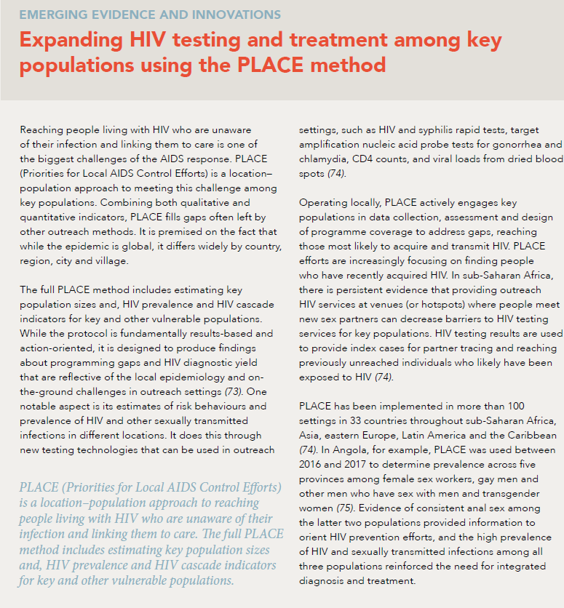
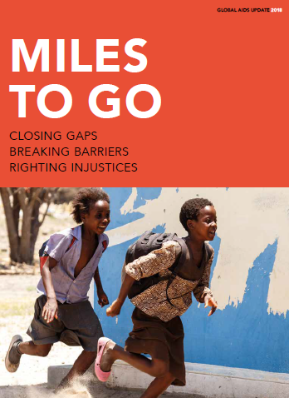
PLACE method: Global picture
The Joint United Nations Programme on HIV/AIDS (UNAIDS) recognizes PLACE as an effective strategy for expanding testing and treatment for key populations.
PLACE has been implemented in at least 35 countries in sub-Saharan Africa since 1999, often several times.

Slide 11
Countries with a PLACE study
 | Africa
Angola | Ghana | Rwanda | Zambia
Burkina Faso | Kenya | Senegal | Zimbabwe
Burundi | Madagascar | South Africa | The Gambia
Chad | Malawi | Swaziland
DRC | Mozambique | Tanzania
Côte d’Ivoire | Namibia | Uganda

Slide 12
Countries with a PLACE study
Asia and the Americas
China | Barbados | Ecuador | Mexico
India | Dominican Republic | Guyana | United States
Kazakhstan | Haiti
Kyrgyzstan | Jamaica
Russia | St. Lucia
Uzbekistan

Slide 13
Problem that PLACE addresses
Local evidence to inform the HIV response is often inadequate.
People most at risk are often the least likely to get services.
Subgroups at highest risk are unknown.
Engagement with stakeholders is often not meaningful.
Tools to monitor the local HIV response are inadequate.

Slide 14
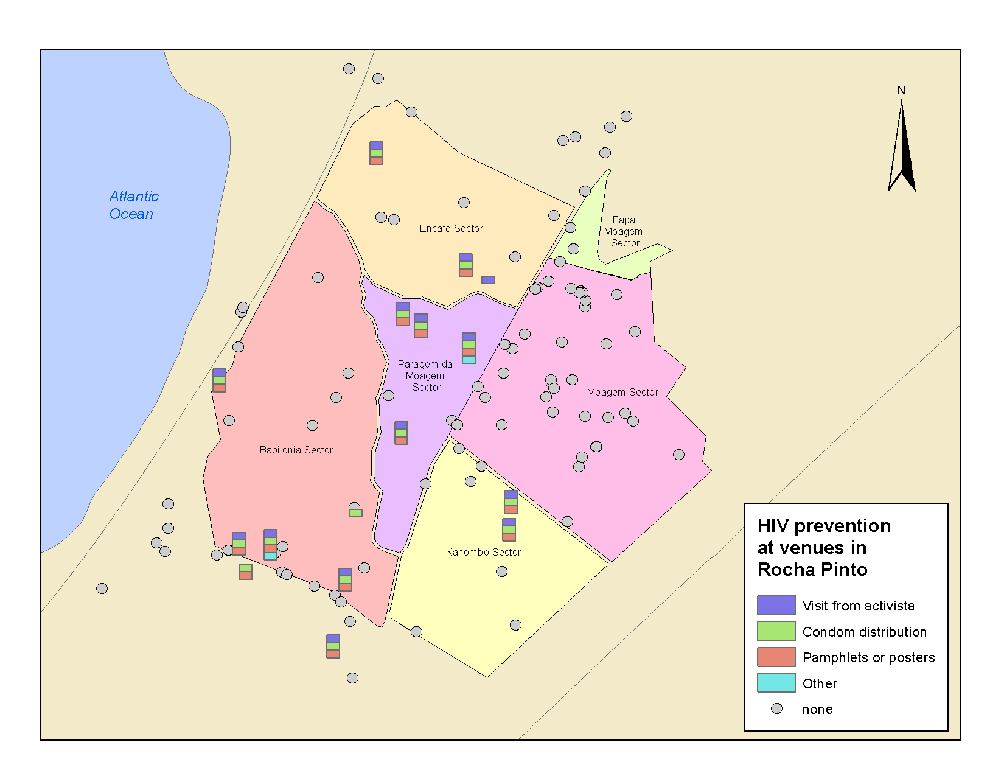
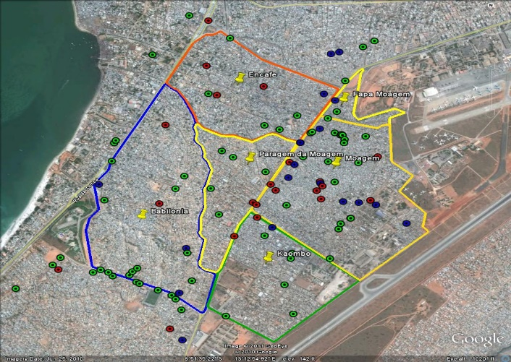
What problem does PLACE
address? (1)
Our failure to adequately focus an effective, locally tailored HIV prevention response where it is most needed
A 2012 PLACE study in Angola
identified venues where people met new sexual partners but where intervention programs were insufficient.
Area with clusters of venues but no prevention program.

Slide 15
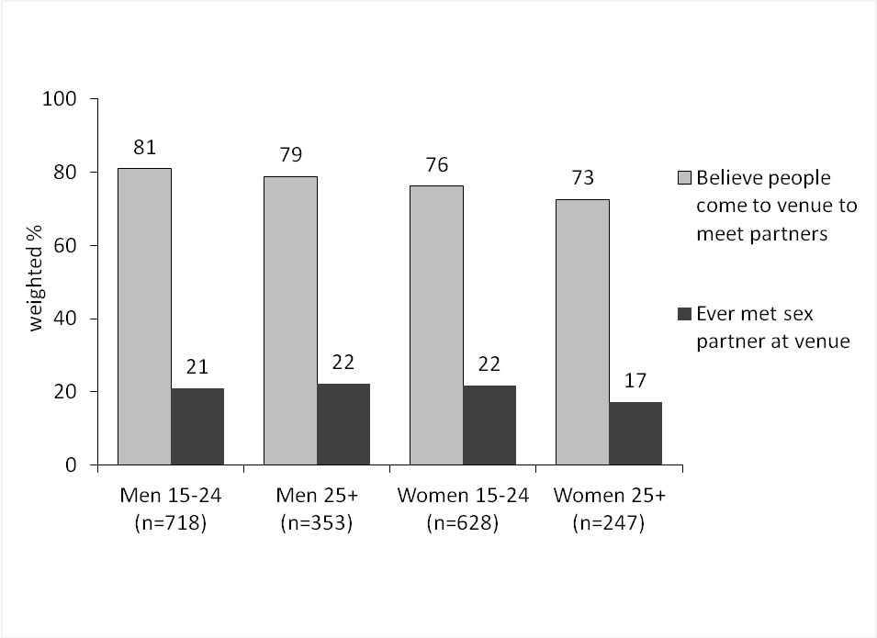
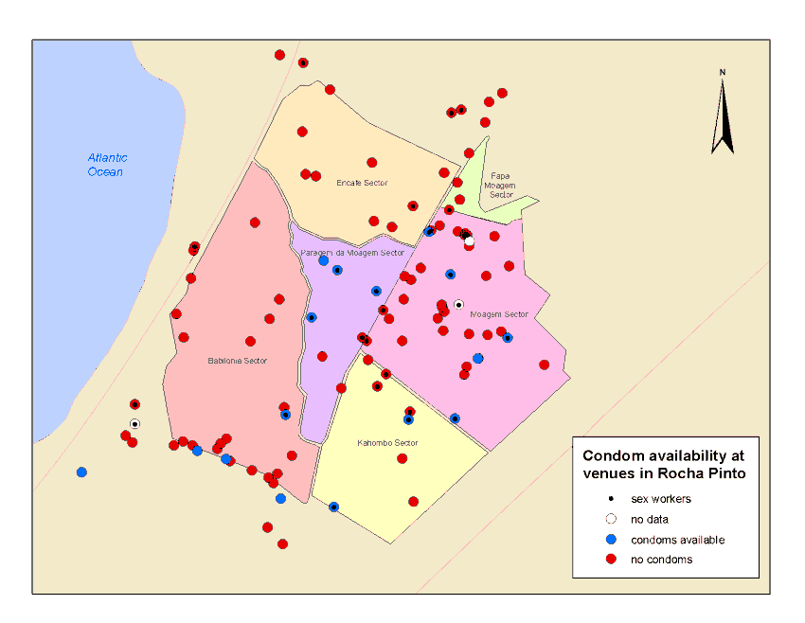
What problem does PLACE
address? (2)
Our failure to adequately focus effective, locally tailored HIV prevention response where it is most needed
The 2012 PLACE study in Angola
Identified venues where people met new sexual partners but where they weren’t getting condoms, which help to prevent HIV transmission.
Almost a fourth of patrons had met a sex partner at the venues, yet most lacked condoms.
Condoms not available

Slide 16
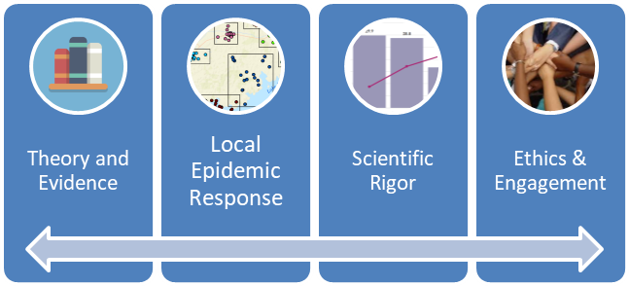
PLACE’s 4 pillars

Slide 17
Epidemiologic theory and evidence
Geographic core areas
Viral load
Venue-based outreach
New partnership rates

Slide 18
Theories, frameworks, and values
Rose: Sick individuals and sick populations
Anderson & Garnett: Mathematical models of transmission and control of sexually transmitted diseases (STDs)
May & Anderson: Transmission dynamics of HIV
Aral: Interventions appropriate to the phase of an STD epidemic
Blanchard, et al.: Epidemiology of STDS in response to control programs
Potterat, et al.: Networks
Boerma, et al.: How HIV spread in rural Tanzania
Boerma & Weir: Proximate-determinants framework
Local knowledge and judgment
Notes:
Rose, G. (2001). Sick individuals and sick populations. International Journal of Epidemiology, 30(3), 427–432. Retrieved from https://doi.org/10.1093/ije/30.3.427.
Anderson, R. M., & Garnett, G. P. (2000). Mathematical models of the transmission and control of sexually transmitted diseases. Sexually Transmitted Diseases, 27(10), 636–643. Retrieved from https://www.ncbi.nlm.nih.gov/pubmed/11099079.
May, R. M., & Anderson, R. M. (1988). The transmission dynamics of human immunodeficiency virus (HIV). Philosophical Transactions of the Royal Society of London. Series B: Biological Sciences, 321(1207), 565–607. Retrieved from https://www.ncbi.nlm.nih.gov/pubmed/2907158.
Aral, S. O. (2002). Determinants of STD epidemics: Implications for phase appropriate intervention strategies. Sexually Transmitted Infections, 78 (Suppl), i3–i13. Retrieved from https://www.ncbi.nlm.nih.gov/pubmed/12083444.
Blanchard, J. F., Moses, S., Greenaway, C., Orr, P., Hammond, G. W., & Brunham, R. C. (1998). The evolving epidemiology of chlamydial and gonococcal infections in response to control programs in Winnipeg, Canada. American Journal of Public Health, 88(10), 1496–1502. Retrieved from https://www.ncbi.nlm.nih.gov/pubmed/9772851.
Potterat, J. J., Rothenberg, R. B., & Muth, S. Q. (1999). Network structural dynamics and infectious disease propagation. International Journal of STD and AIDS, 10:182–185. Retrieved from https://www.ncbi.nlm.nih.gov/pubmed/10340199.
Boerma, J. T., Urassa, M., Senkoro, K., Klokke, A., & Ngweshemi, J. Z. (1999). Spread of HIV infection in a rural area of Tanzania. AIDS, 13(10), 1233–1240. Retrieved from https://www.ncbi.nlm.nih.gov/pubmed/10416528.
Boerma, J. T., & Weir, S. (2005). Integrating demographic and epidemiological approaches to research on HIV/AIDS: The proximate-determinants framework. Journal of Infectious Diseases, 191 (Suppl. 1): S61-S67. Retrieved from https://www.ncbi.nlm.nih.gov/pubmed/15627232.

Slide 19
Proximate-determinants framework
UNDERLYING DETERMINANTS
PROXIMATE DETERMINANTS
HIV Incidence
Sociodemographic factors
Structural factors / stigma
Health interventions
Partnership rates
Condom use and anal sex
Concurrent STI*
ART**/viral load
Needle sharing

Slide 20
Scientific rigor
The third pillar of PLACE is its step-by-step systematic implementation and adherence to standards of scientific research, survey design, and data quality. The results the method yields are HIV prevalence, behavioral indicators, and coverage estimates with standard errors that reflect the sampling design and participant recruitment strategies.

Slide 21
Ethics, Respect, Engagement
PLACE engages key and priority populations in the design and implementation of PLACE and includes processes to safeguard people and data.
Sex Workers
MSM
People Who Inject Drugs
Transgender People

Slide 22
PLACE phases
Preparation: Formative work and planning
Fieldwork: Training, implementation, feedback, and local data use
Supplemental analysis

Slide 23
Preparation phase
A National Steering Committee prepares for study implementation in consultation with stakeholders.
Planning includes adaptation of the protocol; ethical review; stakeholder input; and establishment of the timeframe, budget, and implementing organization, as well as the selection of areas where PLACE will be implemented.

Slide 24
Key protocol decisions
Leadership
Where: Selection of areas
Who: Study populations
Venue typology defined
What: Selection of indicators and tests
How many: Sample size determination
Ethical issues and PLACE readiness
Project staffing, timeframe, & budget
Notes:
More protocol decisions are covered in the PLACE Protocol Decisions Manual, available in the PLACE Tool Kit here: https://www.measureevaluation.org/resources/tools/hiv-aids/place.

Slide 25
Fieldwork phase: 5 steps
Step 1
Step 2
Step 3
Step 4
Step 5
District launch and identify PPAs
Identify venues
Visit and map venues
Conduct biobehavioral survey
Feedback and data use workshop

Slide 26
Supplemental analysis phase
There are often requests to combine local PLACE reports in a comprehensive report or extrapolate the findings to other areas.
Methods for these supplemental analyses are not provided in the PLACE Tool Kit.
Examples of these methods are available in PLACE reports published online.
https://www.measureevaluation.org/resources/tools/hiv-aids/place

Slide 27
How does PLACE work?
In the preparation phase, the National Steering Committee adapts the Sample Protocol and determines where to implement PLACE: for example, in 30 of 120 districts in the country.
The protocol has 12 sections, each requiring adaptation by the committee to guide implementation and data use.
The Sample Protocol is available online in the PLACE Tool Kit, along with tools to help the committee adapt it to the needs of the study.

Slide 28
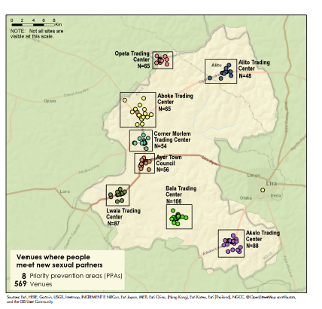
Step 1: Fieldwork launch
In each selected area, a District Steering Committee launches PLACE. One of the first steps is to convene stakeholders to identify priority prevention areas.
These are areas where local evidence and stakeholder insight suggest that HIV incidence is higher.
Example of a selected district in Uganda with priority prevention areas identified
Notes:
This is an example of a country with the shaded areas selected for PLACE.

Slide 29
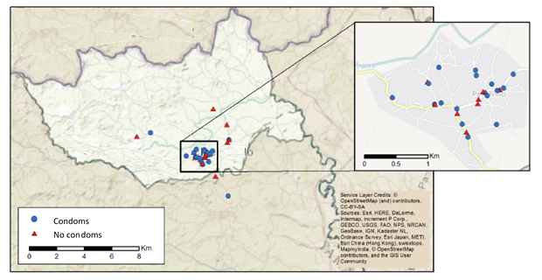
Step 2: In each priority prevention area, community informants are interviewed
Purpose: To identify places where people socialize and meet new sexual partners or where people who inject drugs can be reached
Map of venues where people meet new sexual partners
Notes:
Within those selected subdistricts, we will identify venues where people meet new sex partners. This is an example of one area and venues that have been identified. This is a relatively small area, with 39 venues.

Slide 30
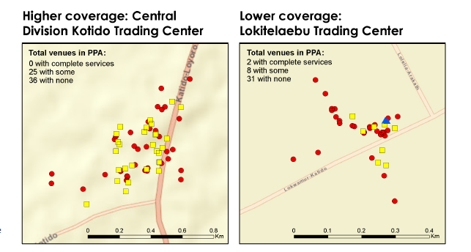
Step 3: Characteristics of venues related to programs are collected
Venue profiles are created based on information obtained
from an interview with an on-site venue informant.
Notes:
When we visit venues, we collect information about the characteristics of that place that are related to programs.

Slide 31
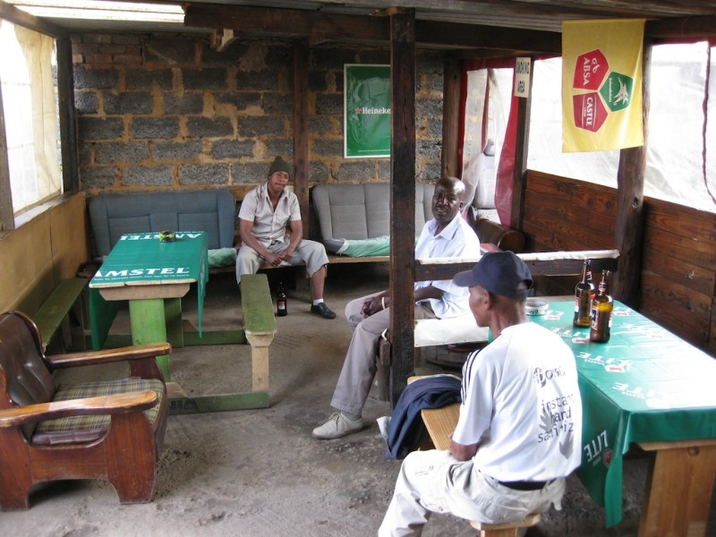
Step 4: A sample of people socializing or working at venues are interviewed and tested for HIV
Finally, the results are used to improve programs in the area.
Notes:
In addition to information about venues, we also collect information from people about their lives, mostly about aspects related to risk for HIV and exposure to services. We test people for HIV as part of their participation in PLACE. Some venues are large, like the disco shown in the photo on this slide, and others are small, like this bar. Information people report about themselves helps programs to understand the behaviors people engage in, their level of risk, and also what services are already reaching people at risk.

Slide 32
Step 5: Outputs reviewed
Meaningful stakeholder engagement
Priority prevention areas identified
Validated master list of venues
Venue profiles
Coverage maps
Size estimates: Key and priority populations
Summary reports or briefs for each local area (district)
Local capacity to use data
Biobehavioral profile of key and priority populations, including:
Demographic profile
Transmission risk
Vulnerability and adverse event (VAE) profile
HIV prevalence
HIV prevention and treatment cascades
Access to and use of HIV services

Slide 33
Actionable data at district level
List of venues
Maps of venues
Characteristics of HIV+ people
Condom availability at venues
Program coverage, by type of person

Slide 34
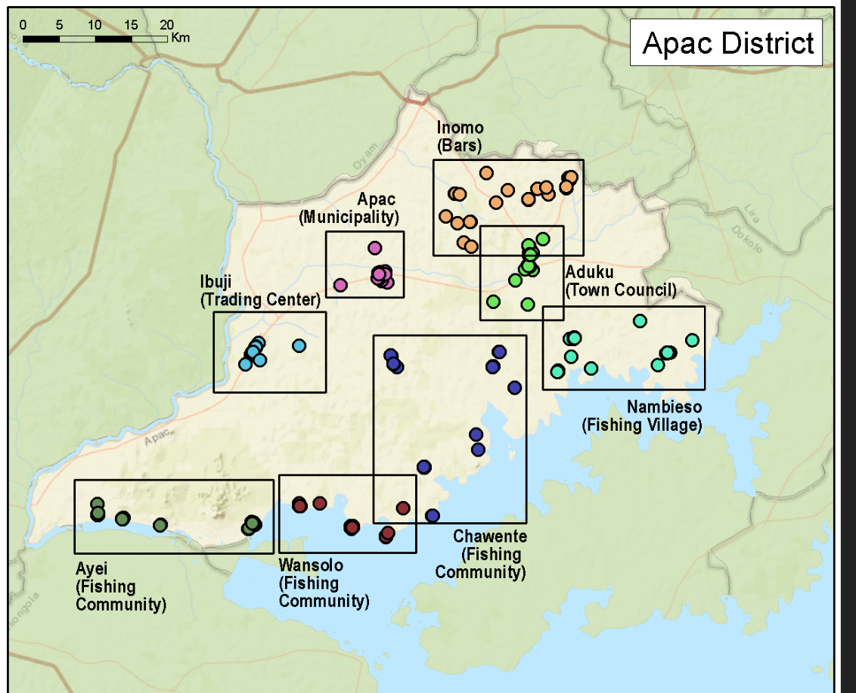
For example: PLACE fieldwork in Apac District, Uganda in 2018
STEP 1
STEP 2
STEP 3
STEP 4
STEP 5: December 12, 2018 review of district reports and action planning workshop
Notes:
For the complete brief summarizing the results of 2018 PLACE studies in Apac and 24 other districts in Uganda, see https://www.measureevaluation.org/resources/publications/fs-18-322z?searchterm=PLACE+Uganda.

Slide 35
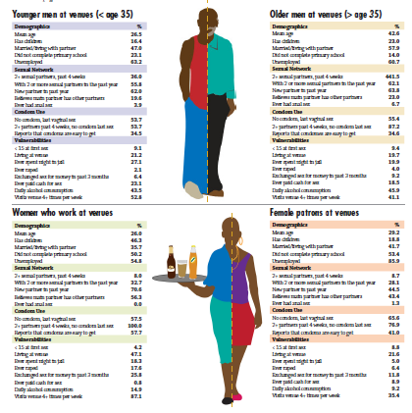
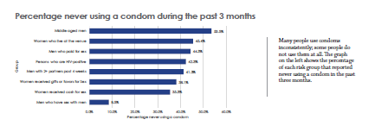
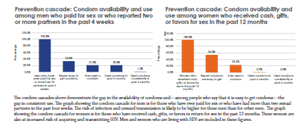
Apac results: Profiles of men and women at PLACE venues
Notes:
Screenshot of MEASURE Evaluation’s Apac District brief: https://www.measureevaluation.org/resources/publications/fs-18-322z?searchterm=PLACE+Uganda.

Slide 36
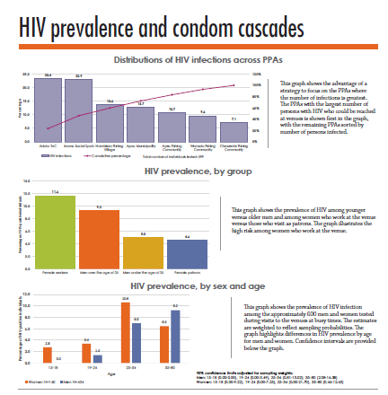
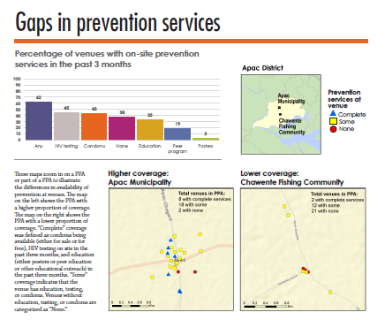
HIV prevalence and prevention
Notes:
Screenshot of MEASURE Evaluation’s Apac District brief: https://www.measureevaluation.org/resources/publications/fs-18-322z?searchterm=PLACE+Uganda.

Slide 37
Relative to other approaches
PLACE does not limit participation to people who meet risk-group definitions.
Key population members do not have to self-identify as such to participate. Stigma may be reduced.
PLACE provides pictures of men, women, and transgender people in a single location, providing insights into social and sexual networks and the HIV transmission opportunities in these networks.

Slide 38
PLACE’s disadvantages
The method will miss people who have new sexual partners but do not go to public venues.
Fieldwork can be challenging: conducted late at night, with long hours on the road and on-site, and training must be thorough.
Self-reported behavior can be biased, and it is difficult to understand the effect of bias on a study’s findings.

Slide 39
PLACE relative to household surveys
Some people at higher risk for acquiring/transmitting HIV do not live in households. They live in venues. Living in venues increases risk, and people who do are missed by household surveys.
Household surveys also miss some mobile people, fisher folk, and students.
People in households report lower partnership rates than people in PLACE venues. Thus with a smaller sample size, we can find more people who are likely to transmit HIV.

Slide 40
Notes:
Before you go out into the field for each step, you will receive additional training on how to select people for interviews and how to ask questions and code responses. For now, we hope you have a good general understanding of the PLACE method.

